Slide 1
WHAT IS CRUISE CONTROL?
Cruise control is a feature in a car that maintains a set speed without needing the driver to press the accelerator. Advanced versions (like Adaptive Cruise Control) can also slow down or speed up depending on other vehicles.

Slide 2
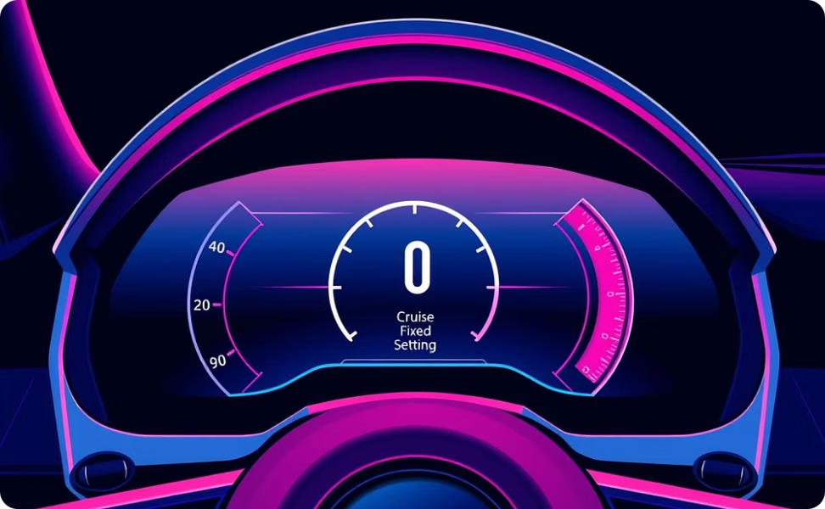
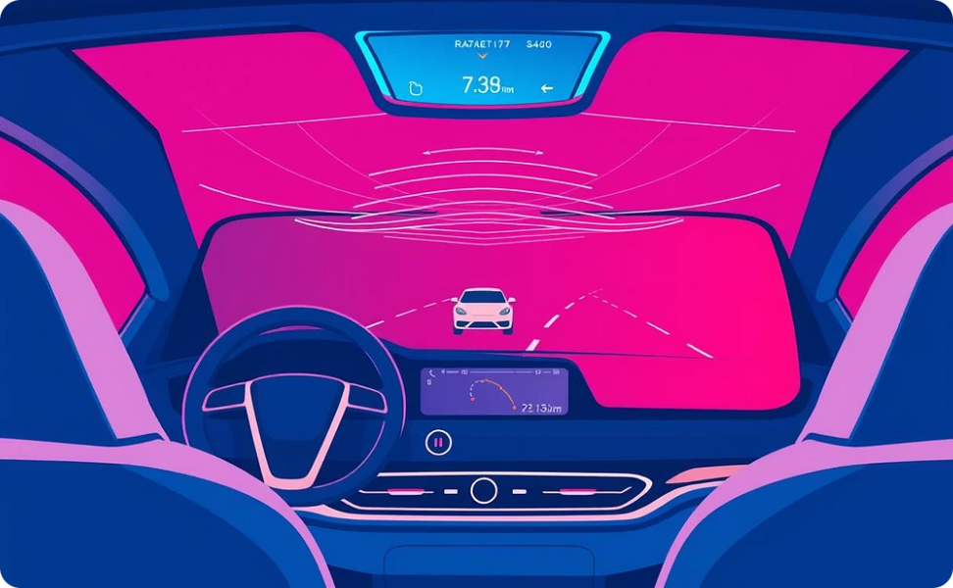
🚗Types of Cruise Control
Traditional Cruise Control
Adaptive Cruise Control (ACC)
This feature maintains a set speed without requiring the driver to press the accelerator pedal, making long drives more comfortable and fuel-efficient.
An advanced version that not only maintains a set speed but also automatically adjusts the vehicle's speed and distance based on traffic flow and other vehicles ahead, enhancing both safety and convenience.

Slide 3
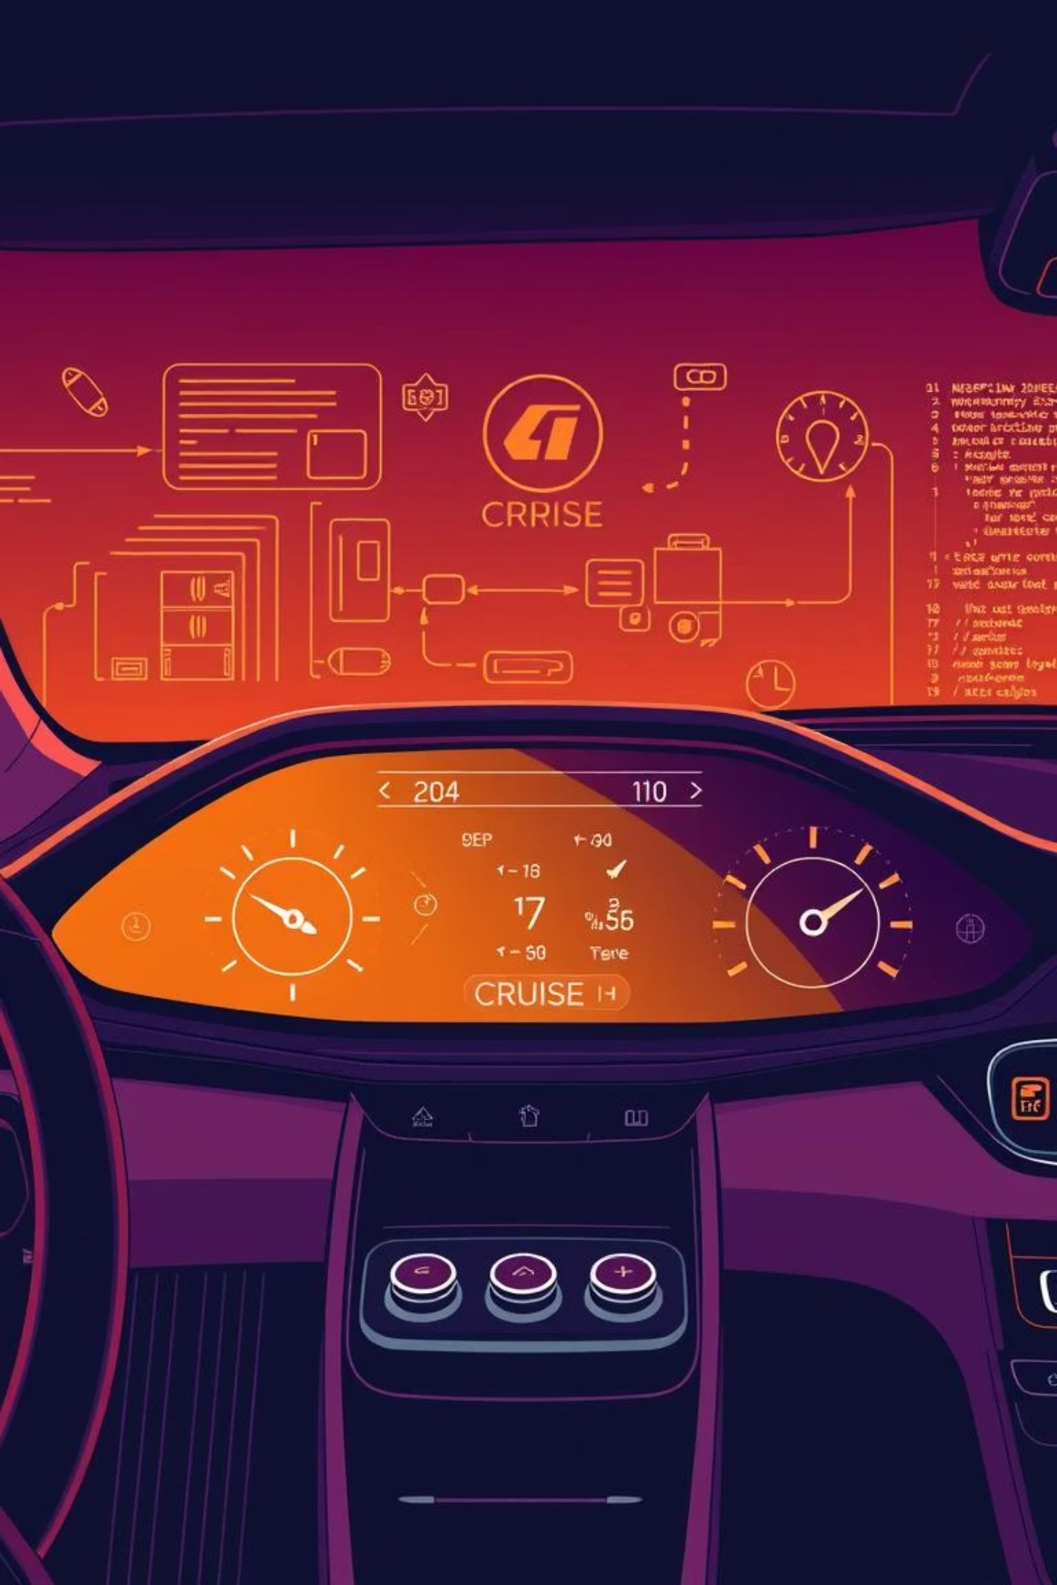
Rigorous Cruise Control Testing with AUTOSAR
Ensuring the reliability and safety of automotive systems like Cruise Control (CCS) is paramount. This presentation outlines a comprehensive, multi-level testing approach for CCS development, strictly adhering to AUTOSAR standards and leveraging advanced tools to achieve robust, compliant software.

Slide 4



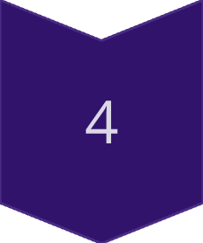

The Complete V-Cycle for Cruise Control Validation
Cruise control testing using AUTOSAR is a systematic process conducted at various software and hardware abstraction levels. The main goal is to verify that the system works correctly under diverse driving conditions and inputs, while complying with AUTOSAR standards. This V-cycle approach ensures thorough validation at every stage.
Requirement Analysis
Define system expectations and functional safety.
Architecture Design
Map functions to AUTOSAR layers.
Test Planning & Setup
Strategize test levels and toolchains.
Multi-Level Testing
Perform unit, integration, BSW, and system tests.
Validation & Regression
Final verification and continuous re-testing.

Slide 5


Phase 1: Defining the Foundation - Requirement Analysis
This initial phase focuses on thoroughly understanding the desired behavior of the cruise control system. It forms the bedrock for all subsequent development and testing activities, ensuring that the final product meets functional and safety objectives.
Objective: Comprehend all functional and non-functional aspects of cruise control operation.
Documents: Utilise Software Requirement Specification (SRS) and ISO 26262 Functional Safety Requirements.
Tasks: Identify all use cases (e.g., speed maintenance, cancellation mechanisms, resume functionality). Define interface signals like VehicleSpeed, BrakeStatus, and SetSpeedCommand.
Output: A comprehensively detailed and testable list of system requirements, serving as the baseline for test case generation.

Slide 6
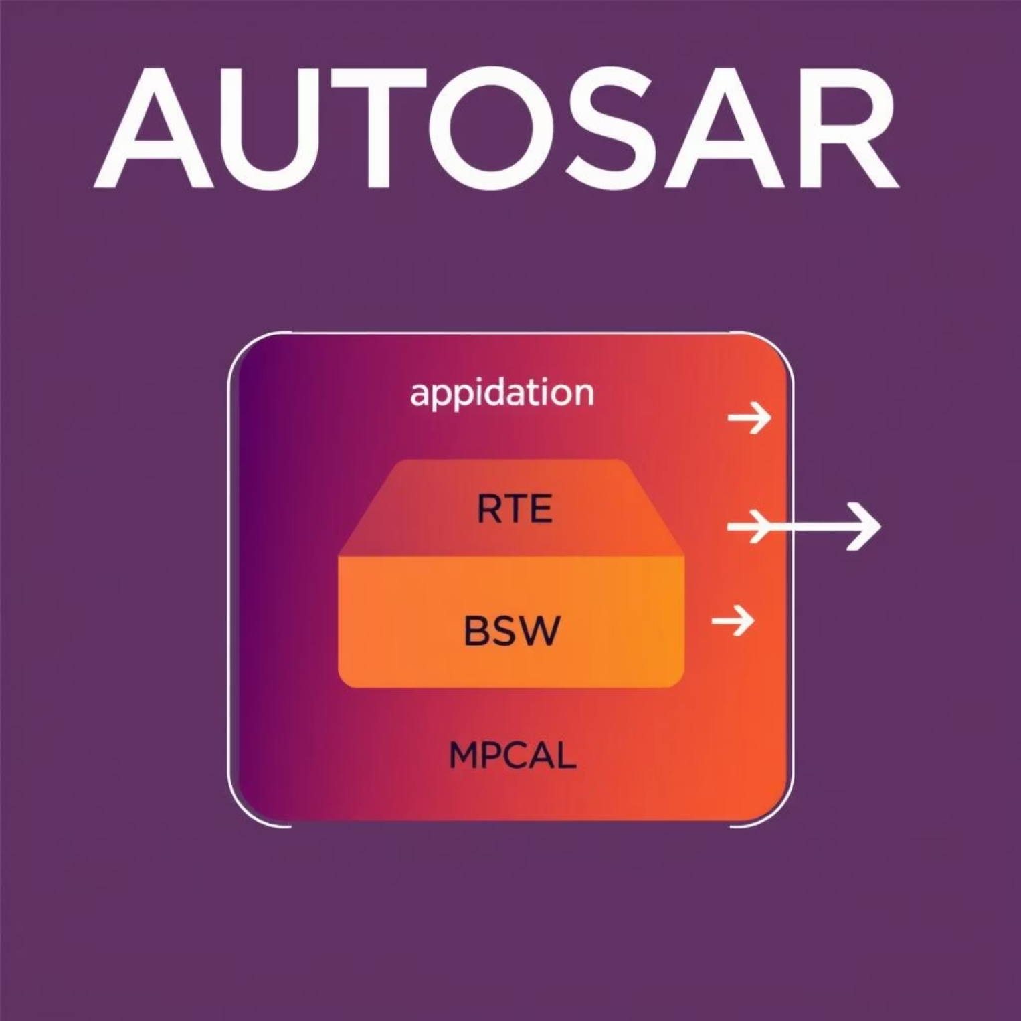

Phase 2: Architectural Blueprint - AUTOSAR Layer Mapping
This stage involves mapping the identified cruise control functionalities to the appropriate AUTOSAR layers, ensuring modularity, reusability, and adherence to the AUTOSAR standard. It defines the software component interactions and signal definitions.
AUTOSAR Layer
Role in Cruise Control
Application Layer
Core cruise control logic (Set, Resume, Cancel functions).
RTE (Runtime Environment)
Facilitates communication between Software Components (SWCs).
BSW (Basic Software)
Interacts directly with the Electronic Control Unit (ECU) hardware.
MCAL (Microcontroller Abstraction Layer)
Provides standardised access to microcontroller's sensor/actuator hardware.
Output: Detailed Software Component (SWC) diagrams, precise signal definitions, and well-defined interfaces for inter-component communication.

Slide 7


Phase 3: Crafting the Testing Strategy
This critical planning phase outlines the entire testing approach, from defining various test levels to selecting appropriate tools and establishing traceability. A robust test plan ensures comprehensive coverage and efficient execution.
Test Levels Defined
Unit, Integration, Hardware-in-the-Loop (HIL), and ASIL-compliant Safety & Fault Testing.
Environment Setup
Detailed planning for test environment configurations, including hardware and software integration.
Tool Selection
Identification and justification of specific testing tools (e.g., Vector CANoe, dSPACE).
Traceability Matrix
Mapping of all test cases directly to their corresponding requirements to ensure complete coverage.
Output: A comprehensive Test Plan Document detailing methodologies, resource allocation, and success criteria for all testing phases.

Slide 8




Phases 4-6: Granular Testing - Unit, Integration, and BSW
These phases involve a systematic, bottom-up testing approach, ensuring the correct functionality of individual components before verifying their interactions and hardware dependencies.
Unit Testing (Application Layer)
Integration Testing (RTE & Components)
BSW + ECU Testing
Verify communication with actual or simulated sensors and actuators, ensuring proper signal paths from application to hardware. Tools: CANoe, INCA.
Isolate and verify individual functions like SetSpeed() and UpdateThrottle() using tools like VectorCAST.
Validate signal flow via RTE and data exchange between components (e.g., BrakeSensor → RTE → CruiseControl). Tools: Vector DaVinci Developer, CANoe.
Example: Inputting Speed = 60 km/h and Set Button Pressed yields TargetSpeed = 60 km/h.
Example: Brake activation leads to signal transmission via RTE, causing cruise control cancellation.
Example: Throttle signal from application passes through BSW correctly to the actuator.

Slide 9
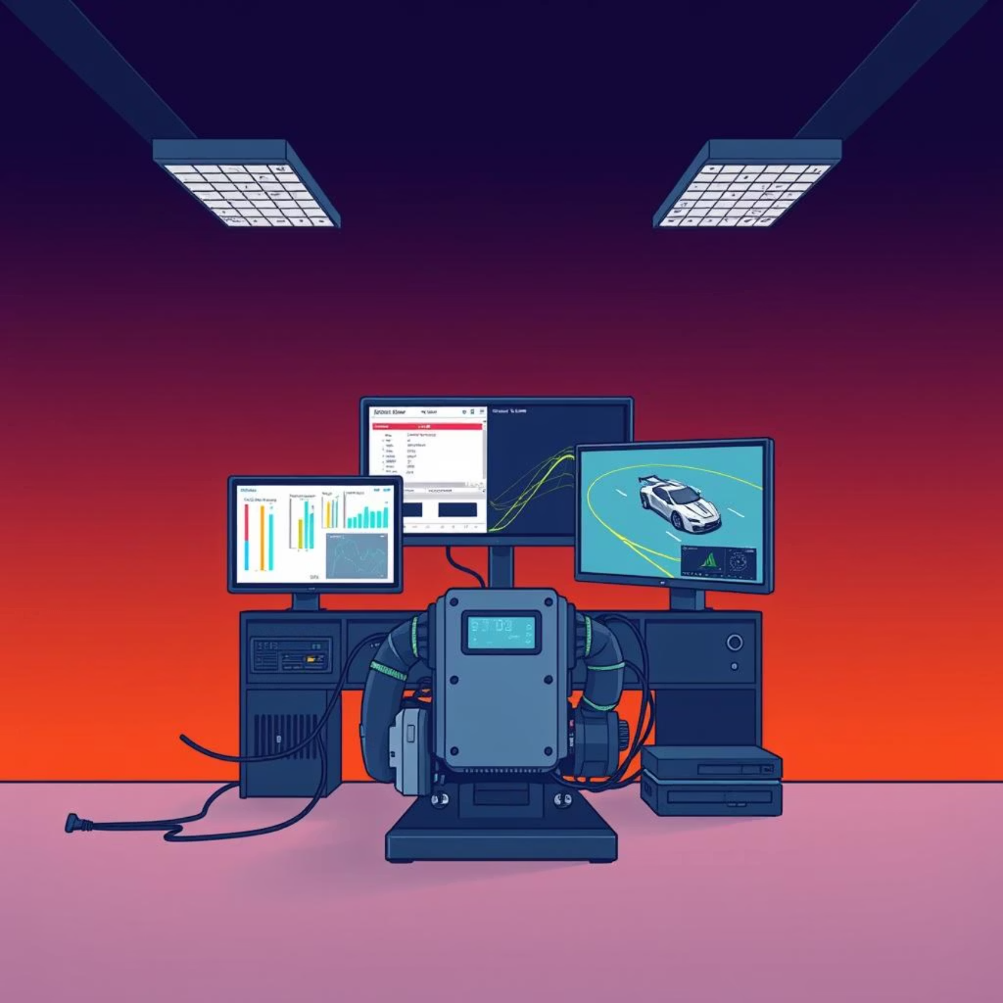

Phase 7: System Validation with HIL
Hardware-in-the-Loop (HIL) testing provides a realistic, comprehensive environment to validate the cruise control system's behavior within a full vehicle setup, mimicking real-world driving conditions.
Scope: Test the complete cruise control system, integrating the actual ECU with a simulated vehicle environment.
Setup: The Cruise Control ECU interacts with a dynamic simulation of vehicle dynamics, road conditions, and environmental factors.
Tools: Specialised HIL platforms such as dSPACE, NI LabVIEW, and ETAS, along with test automation software like ECU-Test.
Scenarios: Evaluate system performance under diverse conditions, including maintaining speed on inclines/declines and handling sensor failures.
Output: Comprehensive verification of the cruise control system's functional behavior and performance under simulated real-world scenarios.

Slide 10




Phase 8: Rigorous Safety and Fault Testing (ISO 26262)
Ensuring compliance with ISO 26262, this phase rigorously tests the system's resilience to faults and its ability to enter a safe state under adverse conditions, critical for automotive safety.
Fault Injection Techniques
Diagnostic Communication
Safe State Verification
Confirm that the cruise control system safely disables itself or transitions to a minimum risk condition upon detecting critical failures (e.g., run-time watchdog failure).
Deliberately introduce faults (e.g., sensor disconnection, signal corruption) to verify the system's diagnostic and safety mechanisms.
Utilise Unified Diagnostic Services (UDS) requests via tools like CANdelaStudio to read fault codes and verify diagnostic routines.
Output: A detailed Safety Report, demonstrating strict adherence to ASIL (Automotive Safety Integrity Level) requirements and robust fault handling.

Slide 11



Phases 9 & 10: Final Validation and Continuous Assurance
These concluding phases ensure the cruise control system meets user expectations and remains stable and reliable throughout its lifecycle, adapting to future updates.
Validation & Acceptance Testing
Regression Testing
Verify the complete system against user needs through real vehicle road testing, performance checks, and usability assessments.
After any code updates or modifications, re-execute existing test suites to guarantee no new defects have been introduced and previously resolved issues remain fixed.
Output: Final Test Report and Stakeholder Approval.
Output: Verified System Stability and Repeatable Test Environment.

Slide 12









Key Tools for AUTOSAR Cruise Control Testing
A suite of specialized tools is essential for executing the multi-faceted testing process of AUTOSAR-compliant cruise control systems, ensuring accuracy and efficiency at every stage.
Vector CANoe: Essential for signal simulation, network analysis, and CAN bus testing.
ECU-Test: Automation of ECU-level tests and robust test management.
dSPACE: Leading platform for Hardware-in-the-Loop (HIL) testing.
VectorCAST: Facilitates automated unit and integration testing.
TPT (Testing and Production Tool): Comprehensive test automation, requirement linking, and model-based testing.
INCA & CANape: For precise ECU parameter monitoring, signal measurement, and calibration during development and testing.
DaVinci Developer: Key for AUTOSAR Software Component (SWC) modeling and configuration.
CANdelaStudio: Used for diagnostics development and UDS (Unified Diagnostic Services) request testing.
MATLAB/Simulink: Provides capabilities for model-based design and testing, including simulation and code generation.

Slide 13
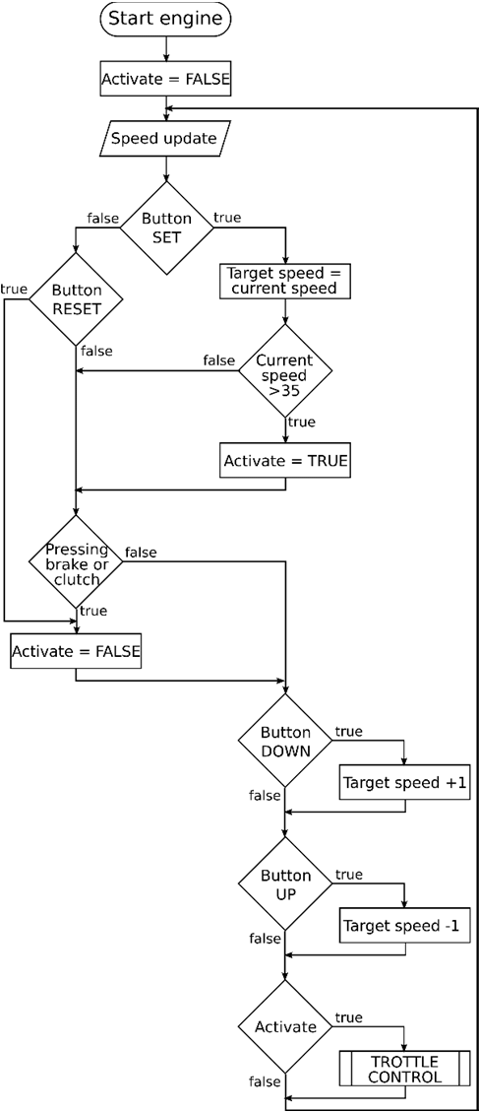
FLOW CHART

